Slide 1
Module 1 DBMS Extensions and Example Data Warehouses
Lesson 6: Data Warehouse Standards in Health Care
Notes:
Welcome to Lesson 6 of Module 1 on Relational Database Support for Data Warehouses
Opening question
- What factors inhibit usage of medical data warehouses such as SAFTINet?

Slide 2
Lesson Objectives
Gain insights about the scope of moderate size data warehouses
Grasp development difficulties
Reflect about importance of incentives for voluntary data providers and usage difficulties
Notes:
Objectives:
Gain insights about the scope of moderate size data warehouses
Grasp difficulties about cooperation and data integration in moderate size data warehouses
Study examples of data warehouses to clarify concepts
Gain insights about intangible benefits for participation by data providers

Slide 3
OMOP
Observational Medical Outcomes Partnership
Public/private partnership
Standard vocabulary and data model
Suite of tools for data integration, queries, and data generation procedures
Follow on projects for research about medical evidence and open source software tools
Notes:
Touted as tools for standardization but more likely base for integration
Version 5 in 2014

Slide 4
Common Data Model (CDM)
Treatment (drug, procedure), Occurrence (observation, visit, condition, death, exposure)
Person
Location
Payer plan
Provider
Cohort
Organization
Care site
Time
Notes:
37 tables
Person centric with person and time captured for each encounter
Major dimension tables
Person, provider, cohort
Location, organization, care site, payer plan
Major fact tables
Observation, drug exposure
Occurrence: condition, death
Cost: drug, procedure

Slide 5
CDM Schema Diagram
Notes:
OMOP 5.0 Common Data Model Specifications
No copyright permission needed: http://omop.org/sites/default/files/OMOP%20CDM%20v5%20draft%20specifications%2015may2014.pdf
Document in class website
Standardized areas:
Clinical data
Health care economics
Health care system
Vocabulary
Derived elements

Slide 6
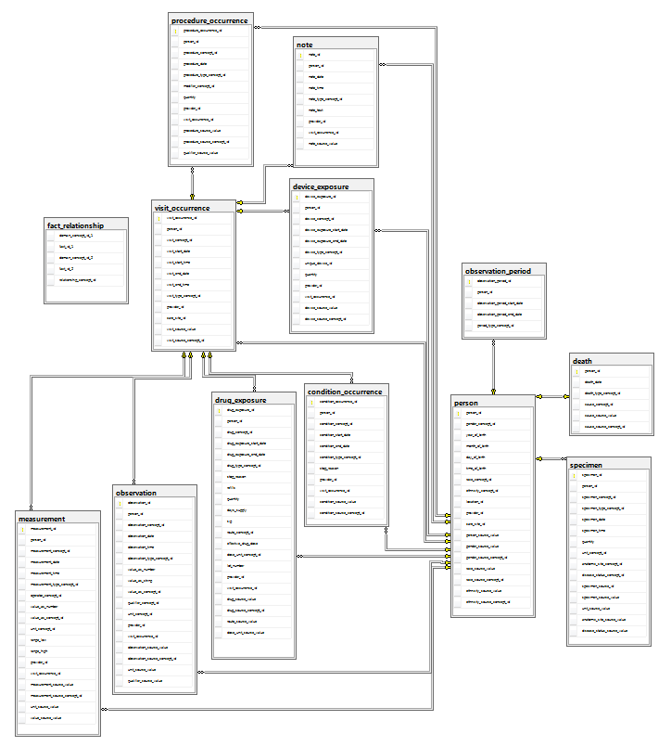
Schema Diagram for Clinical Data
Notes:
copyrighted by the Observational Health Data Sciences and Informatics (www.ohdsi.org).
This schema diagram, from the website of the Observational Health Data Sciences and Informatics, shows details of the OMOP CDM for standardized clinical data. OMOP 5.0 Common Data Model specification. To see the diagram clearly, you should enlarge the diagram. The diagram uses a key symbol by a parent table and infinity symbol by the related child table. The schema diagram contains a constellation schema with various fact tables (such as procedure occurrence and death) and two dimensions (person and observation period).

Slide 7
Schema Pattern Variations
M-N relationships complicate schema patterns
Clinical data
Person to measurement (1-M)
Person to visit occurrence (1-M)
Visit occurrence to measurement (1-M)
Notes:
The OMOP CDM contains variation from the standard schema patterns. As shown in the previous slide, the ERD for the standardized clinical data contain M-N relationships rather than just 1-M relationships in the standard schema patterns. Person is the dimension table with 1-M relationships to three major fact tables (Visit_Occurrence, Death, and Specimen). The other fact tables have 1-M relationships with Visit_Occurrence and Person. For example, 1-M relationships exist from Person and Visit_Occurrence to Measurement and Observation. Measurement and Observation are associative entity types representing M-N relationships. Thus, the ERD for the standardized clinical data complicate the standard schema patterns with M-N relationships.

Slide 8
SAFTINet
Scalable Architecture for Federated Translational Inquiries Network
Significant implementation of OMOP data model
Supports comparative effectiveness and quality improvement research
Network of clinical and Medicaid claims data
Data integration tools and query portal
Notes:
Implementation:
Subset of OMOP CDM
Data integration specifications
Data integration tool to facilitate participation: ensures HIPAA compliance for medical identifiers
Query portal
Work with providers to populate data warehouse
Intangible and indirect benefits to data providers

Slide 9
SAFTINet Data Model
Occurrence (visit, condition, death, procedure, observation)
Person
Provider
Organization
Care site
Time
Notes:
CDM subset
Dimensions: Organization, Care_Site, Provider, Demographic
Fact tables: occurrence tables for visits, drugs, conditions, procedures, and observations
Data warehouse seems modest but barriers to participation and usage
Barriers to participation
Some cost to data providers
Regulatory barriers
Indirect and intangible benefits

Slide 10
Governance and Usage
14 health care organizations, 100 primary care practices, 500 providers, 400,000 patients
Claims from payers in 3 states
Established governance committees
Usage difficulties with internal review boards and approval of data providers
Notes:
Data warehouse seems modest but barriers to participation and usage
Barriers to participation
Some cost to data providers
Regulatory barriers
Indirect and intangible benefits

Slide 11
Summary
Standards for observation medical data
OMOP Common Data Model
SAFTINet federated data warehouse
Optional participation by data providers
Notes:
Participation typically compulsory in commercial organizations after development decision is made.
Benefits
Difficult to provide for data providers
External mechanism to support participation

